Slide 1


Project 3
Singapore Travel Fair Campaign
Kenneth Lim

Slide 2
Agenda
Problem Statement
2. Data Pre-processing + EDA
3. Data Modelling
4. Results
5. Conclusion and Recommendations

Slide 3
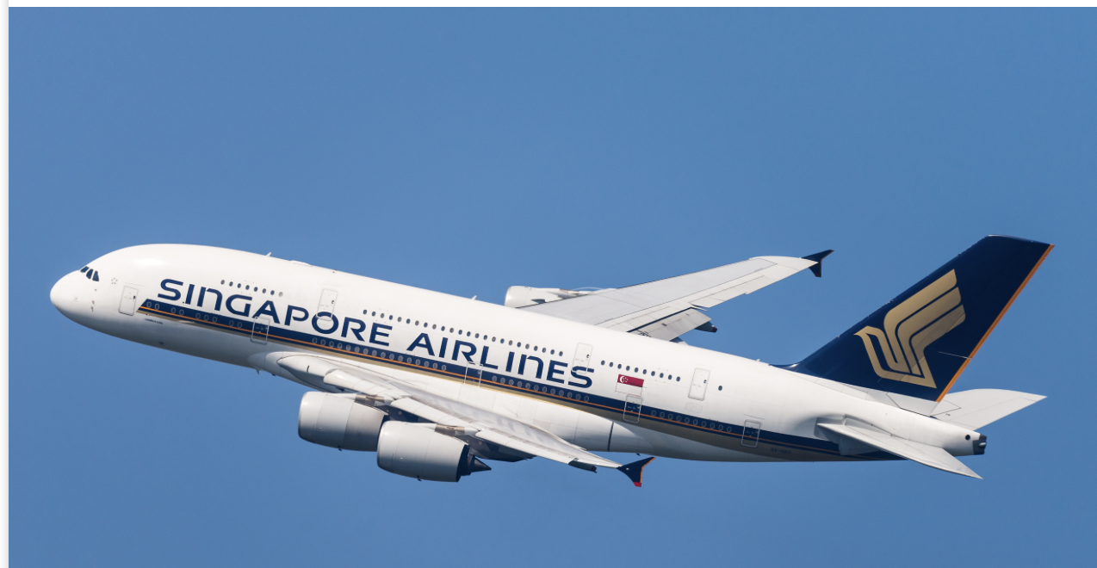
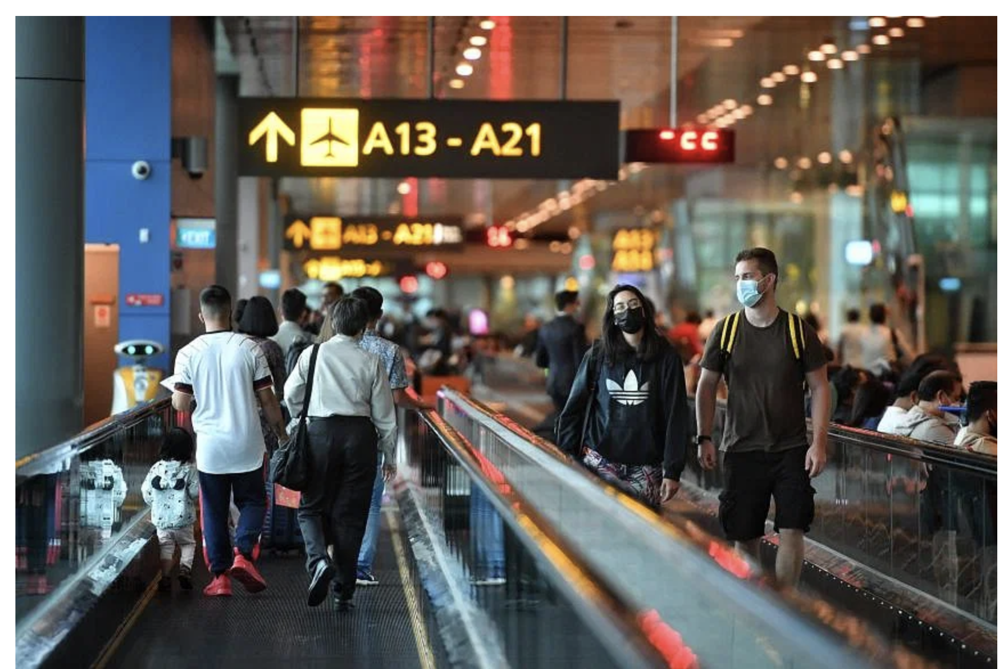
Problem Statement
Singapore lifts remaining Covid-19 pre-departure testing measures in Feb 2023
Surge in Travel bookings and holidays among Singaporeans
Assist Marketing and Operations team in an online local travel technology agency to digitalize their travel promotion packages by training of ML model
Collection of Subreddit travel posts for feedback analysis
Notes:
Sgreans love to travel and have been restricted to during 2 yrs of covid-19
Expect rising demand in travel bookings and holidays among Singaporeans
Assist Marketing and Operations team in an online local travel technology agency to digitalize their travel promotion packages -> done through collection of subreddit posts for analysis and model training
Target subreddit posts on travel to collect text info for feedback analysis before building the ML model

Slide 4
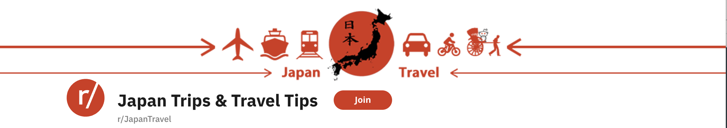
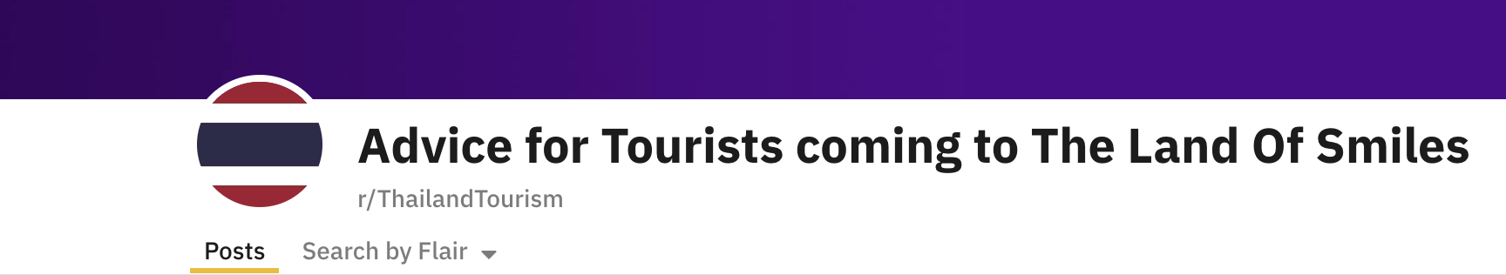
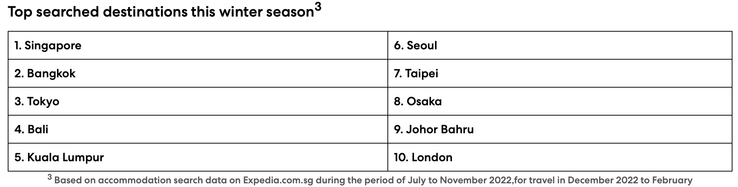
Why Select Subreddit of these countries?
- “Recent study from the Expedia Team showed that 66% of Singaporeans prioritize experiences and travel over things in life Post Covid-19 Pandemic”
Source: https://www.expedia.com.sg/stories/press/expedia-66-of-singapore-travellers-prioritise-experiences-and-travel-over-things-in-life-post-pandemic/
Notes:
Based on recent article from expedia team, at least 66% of Sgreans prioritise new experiences and travel over other things in life post pandemic!
Bangkok and Tokyo emerged as top travel destinations among travellers in SEA region -> target Japan and Thailand subreddits

Slide 5
Data Pre-processing
Remove web URLs, non-words and special characters
Tokenize text sentences into lower case words
Filter common stopwords and keywords relating to Japan and Thailand
Pass into CountVectorizer/TFID Vectorizer for N-gram word feature analysis
Notes:
Remove urls, non-words/foreign text, special chars with no meaning
Tokenize text sentences into lower case words
Apart from common English stopwords, need to filter additional words commonly associated with Japan and Thailand (e.g. Bangkok, Phuket, Tokyo, Osaka etc)

Slide 6
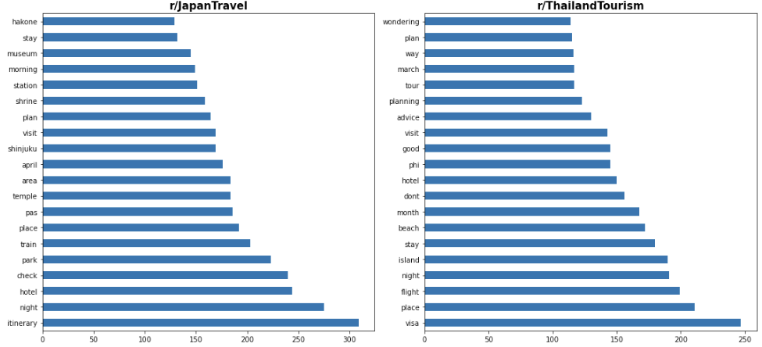
Uni-gram
Notes:
Words such as 'train', 'park', 'station', 'shrine', 'museum' are commonly associated with the sights and transportation Japan, while 'beach', 'islands', 'visa' are associated when travellers plan for their vacation to Thailand.

Slide 7
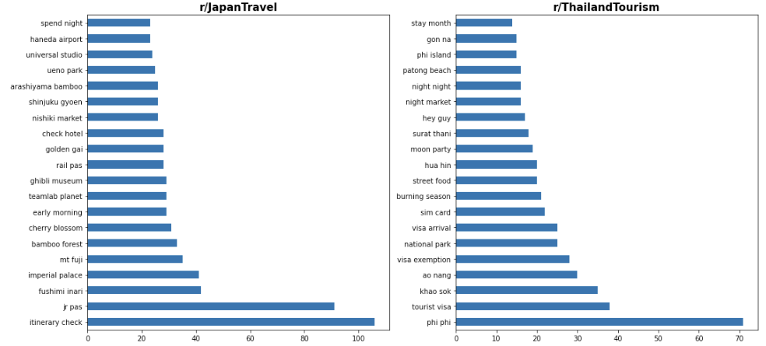
Bi-gram
Notes:
Top Bi-gram words reveal noun words surrounding places(mt fuji, imperial palace, bamboo forest), transportations(Haneda airport) and essential items(JR Pass) that have stronger association with Japan and Thailand respectively as compared to those observed in the Uni-gram plot.
Elaborate what some of the common words meant
Thailand: visa arrival/exemption -> for tourists of other nationalities visiting thailand
night market: places for cheap shopping, food, and nightlife ambience
thailand is more of a country to relax and enjoy rather than sightseeing based on inferrence

Slide 8
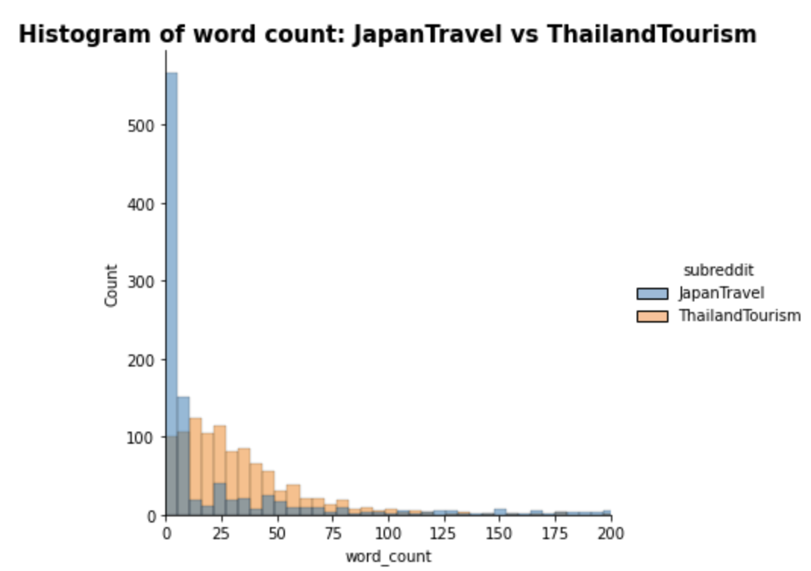
Word Count
Notes:
Both r/JapanTravel and r/ThailandTourism have approximately similar mean word count. Both subreddits have skewed distributions towards the right. JapanTravel has 5x more redundant or empty posts than ThailandTourism
Hypothesize that reddit posts concerning ThailandTourism will have a higher accuracy aka lower misclassification rate than JapanTravel

Slide 9
Data Modelling
Goal: To train a novel prototype NLP Classifier Model that can accurately classify under the correct subreddit categories in long-term for further fine-tuning and deployment
Bag-of-Words
Overall individual word counts
Word frequency count
Vectorization
Condense individual words into sparse matrix of array
Evaluation Metric
Reduce Misclassification rate
Optimize accuracy and ROC-AUC metrics
Classification Algorithms
Naïve Bayes
Logistic Regression
Decision Tree
RandomForest
GradientBooting
Notes:
Objective of the model is to correctly classify incoming posts into the correct subreddit categories

Slide 10
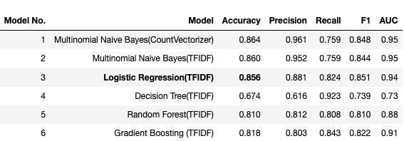
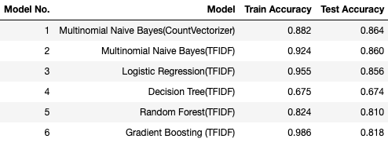
Results
Notes:
From the summary tables of the various classification metrics that we have compiled on the different models, it can be observed that Model 1: Multinomial Naive Bayes(Count Vectorizer), Model 2: Multinomial Naive Bayes(TFIDF) and Model 3: Logistic Regression(TFIDF) performed the best in terms of accuracy. However, the final model that we will be selecting for potential deployment to production will be model 3.
Although Multinomial Naive Bayes(TFIDF) shows similar degree of overfitting on the test data as compared to Logistic Regression(TFIDF), its other classification metrics are not as consistent throughout. This can be inferred from the confusion matrix in both the CountVectorizer and TFID versions of Naive Bayes model having higher False Negatives(Misclassification of ThailandTourism). In this scenario where we want to optimise our binary classification model to reduce the misclassification rate for the 2 classes so as to correctly classify all incoming posts into JapanTravel and ThailandTourism, the Logistic Regression(TFIDF) model will be the present goto recommendation

Slide 11
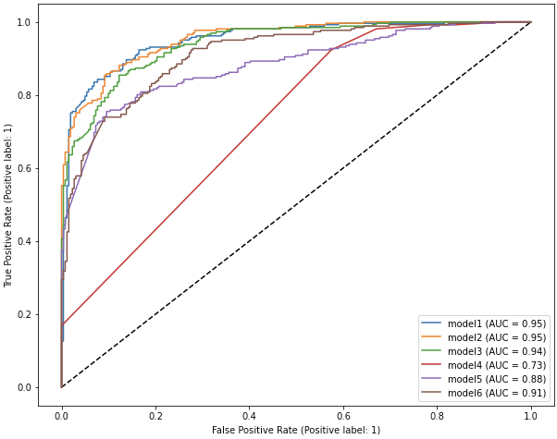
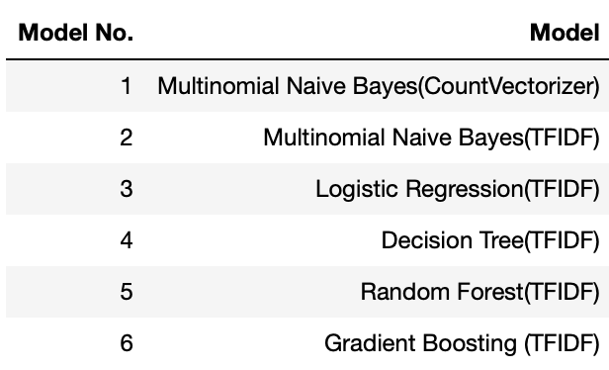
ROC-AUC Curve
Notes:
Although the Naïve Bayes models scored the top in terms of ROC-AUC, their scores are still relatively comparable to logreg.
Based on our earlier requirement on optimizing the reduction misclassification rate of both classes together, logreg will still be the ideal choice

Slide 12
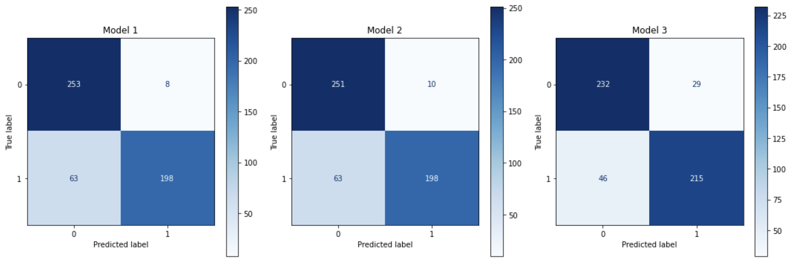
Confusion Matrix
Model 1: Naïve Bayes (CountVectorizer)
Model 2: Naïve Bayes (TFIDVectorizer)
Model 3: Logistic Regression (TFIDVectorizer)
Notes:
- Continuing on from our previous explanation on the summary metrics of the previous models, we can see that model 3 (Logistic Regression TFIDF) has a balanced amount of false positives and false negatives as compared to the Multinomial Naive Bayes models (Model 1 and Model 2). Since our goal is to optimise the reduction of incoming posts having misclassified into r/JapanTravel and r/ThailandTourism, as well as considering the model's performance on predict correctly on classifying unseen posts in the long term, it would be ideal to select Model 3 over Model 2/Model 1 when considering for production deployment

Slide 13
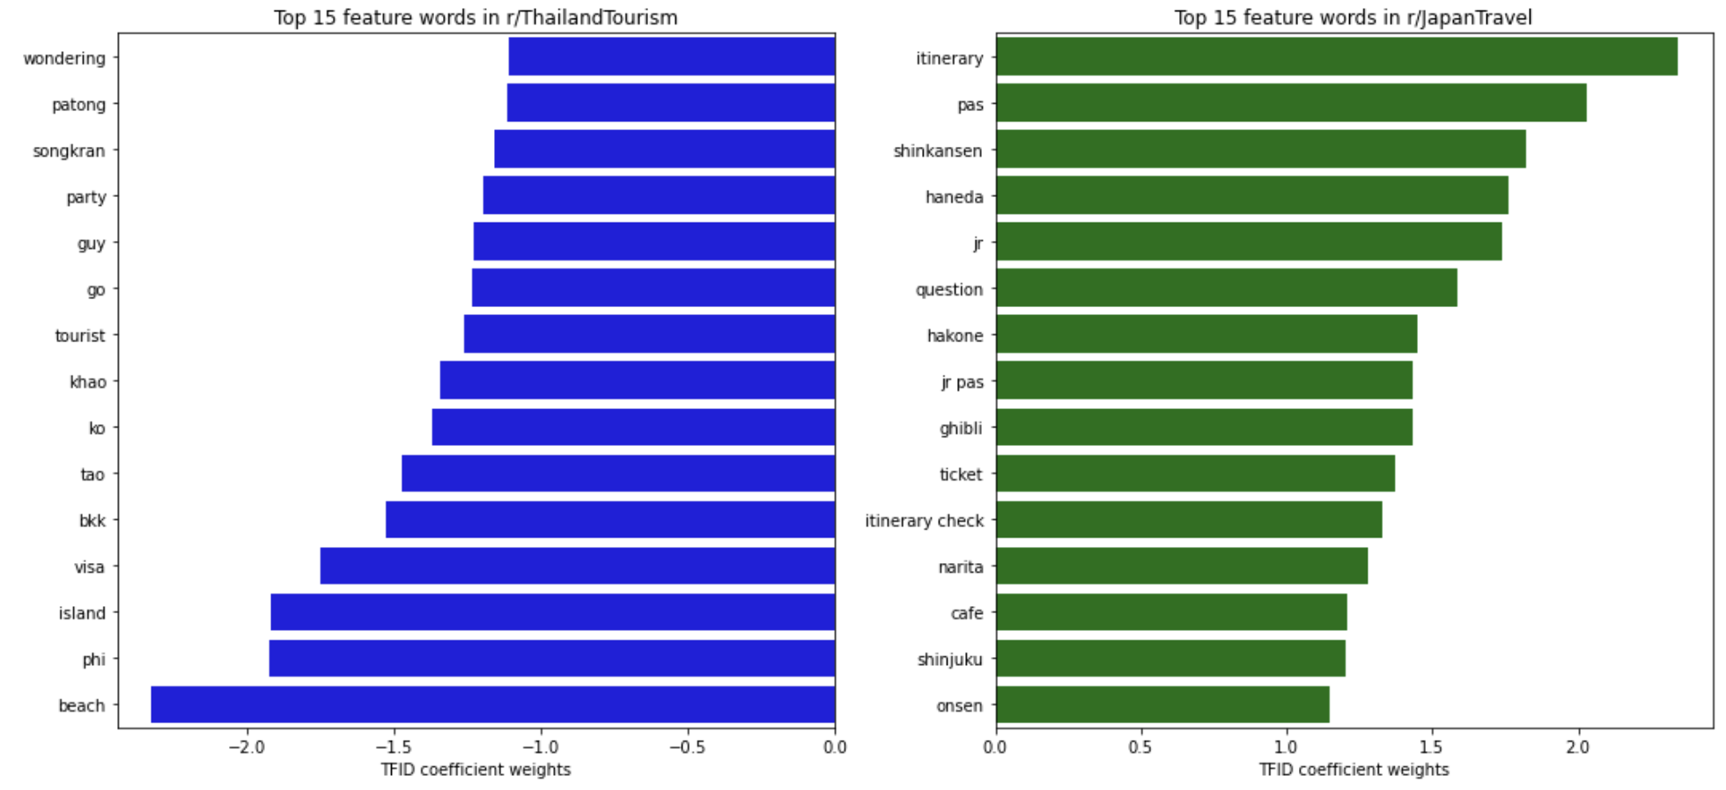
Word Feature Importance
Notes:
1 unit increase in new post having the word 'itinerary' increases the odds by log 2.34x of having it to be successfully classified in r/JapanTravel, holding all other selected word features in the model constant
1 unit increase in new post having the word 'beach' increases the odds by log (-2.32x) of having it to be successfully classified in r/ThailandTourism, holding all other selected word features in the model constant

Slide 14
Accuracy: 85.6%
Conclusion
Selected Model for Production: TFIDF, Logistic Regression
ROC-AUC: 0.94
NLP Classifier is successful in gathering and segregating travel feedbacks from the web
Enables Marketing and Operations team to leverage on this information to execute their campaigns for upcoming travel fairs/fairs

Slide 15
Recommendations
1. Train on larger validation dataset consisting keywords throughout all 4 seasons of the year
2. Deep Learning techniques such as Recurrent Neural Networks for sequential text data. Pre-trained models on existing larger dataset and predict its performance on r/JapanTravel and r/ThailandTourism
3. Employ the model to train on recommendations and feedback from Singapore reviews to validate model’s performance
Notes:
1. Duration of the dataset was scrapped with posts created from early to middle of March. Japan has seasonal sights that vary throughout the year, which will affect the type of words passed and selected by the model, which could impact the model's performance during different season cycles. It would be feasible to consider training on a larger validation dataset in groups of the various months corresponding to the different seasons
2. Employ Deep Learning techniques such as Recurrent Nerual Networks(RNN) that have better predictability in processing sequential text data in order to better classify incoming unseen posts accurately in JapanTravel or ThailandTourism. Transformer-models pre-trained on existing data within the same domain(travel, vacation) for model validation
3. The subreddits were taken from an international community due to lack of forum feedback from Singaporean travellers to these places. Hence, the validation dataset could be trained on text information taken from local subreddit forums instead when possible to validate its performance(difference of interest context between international and Sgrean tourists)

Slide 16
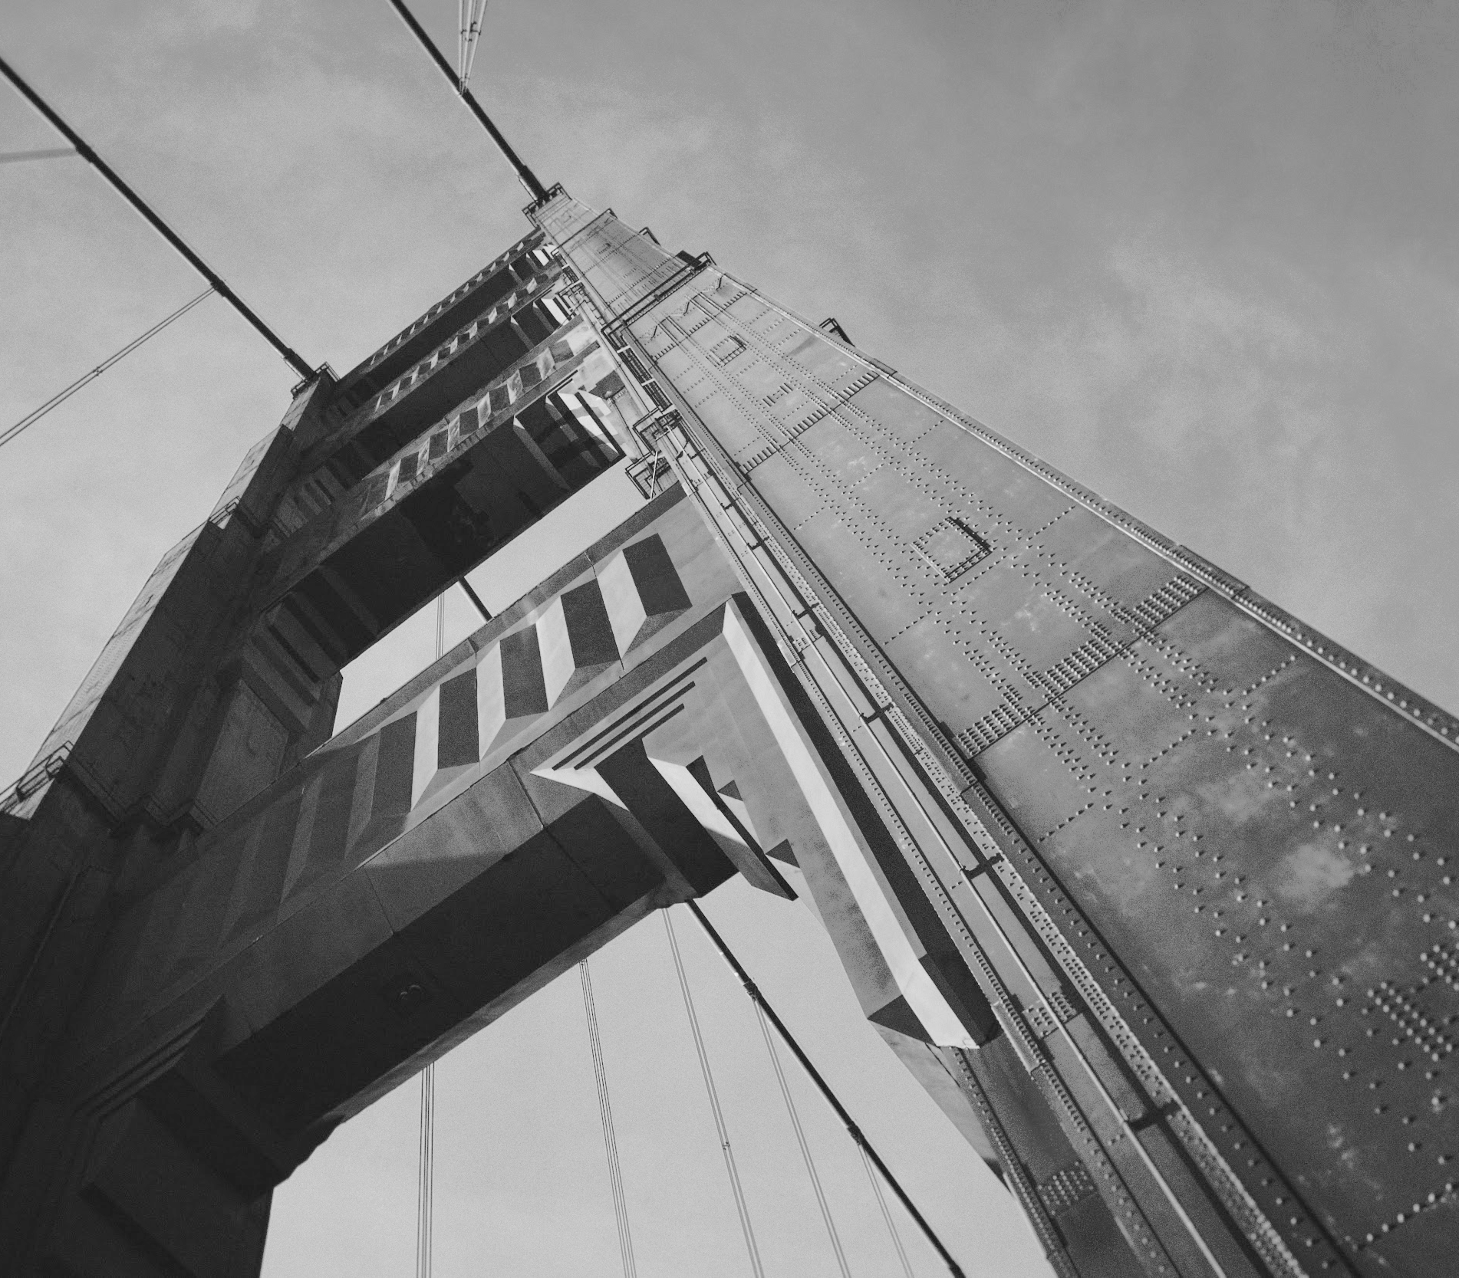
Thank You
Contact us:
TheSGTravelGuru
555 Siam-Tokyo Street
Singapore, SG 12345
the_sg_travel_guru@example.com
www.TheSGTravelGuru.com

Slide 17
Sources
1. https://www.straitstimes.com/life/travel/bangkok-tokyo-and-bali-are-top-year-end-destinations-among-singapore-travellers
2. https://www.travelandleisureasia.com/sg/news/year-end-travel-destinations-among-singapore-travellers/
3. https://www.straitstimes.com/singapore/singapore-will-lift-remaining-covid-19-border-restrictions-from-feb-13
4. https://www.expedia.com.sg/stories/press/expedia-66-of-singapore-travellers-prioritise-experiences-and-travel-over-things-in-life-post-pandemic/
5. https://www.v7labs.com/blog/transfer-learning-guide#h2

